Slide 1



Digital Culture Newsletter
Here is where your presentation begins

Slide 2

Table of contents
01
04
02
05
03
06
Headline news
Tips & tricks
In depth analysis
Upcoming events
Behind the scenes
Community corner

Slide 3



01
Headline news

Slide 4


Headline news
When it comes to writing the headline news for a newsletter, it's important to grab the reader's attention and entice them to read further. Here are some tips for crafting an effective headline:
Keep it short and sweet: A concise headline is more likely to catch the reader's eye and make them want to read on
Be specific: Use specific details or numbers in your headline to give readers an idea of what they can expect to learn
Make it relevant: Choose a topic that is timely and relevant to your audience
Stay tuned for more updates on this exciting development as we continue to innovate and push the boundaries of what's possible!

Slide 5
In depth analysis
Unveiling complexity
Useful recommendations
Explore the heart of your subject with the in-depth analysis. Peel back layers, revealing the intricate details that matter. Whether it's a product feature or a social concern, this section is your space for careful examination. Provide readers with valuable insights, expert perspectives, and data-driven clarity
Explore the heart of your subject with the in-depth analysis. Peel back layers, revealing the intricate details that matter. Whether it's a product feature or a social concern, this section is your space for careful examination. Provide readers with valuable insights, expert perspectives, and data-driven clarity

Slide 6
Behind the scenes
Unmasking creation
Art of composition
The collaborators
Delve into the behind-the-scenes process, sharing insights on idea generation, content creation, and design execution. From brainstorming sessions to final touches, offer an exclusive look at the creative journey
Step into the realm of meticulous craftsmanship. Here, we unveil the artistry behind your newsletter's production. Explore the meticulous process of curating content, refining prose. Readers gain an appreciation for the skillful hands behind the newsletter
Introduce the diverse team of contributors who passionately shape each edition. By acknowledging their dedication, you deepen the reader's connection and offer a behind-the-scenes view of the collective effort driving your newsletter's success

Slide 7
Tips & tricks
Time Management
Networking
Communication
“Break your day into smaller chunks and focus on one task at a time. Take short breaks in between to stay fresh”
“Attend events, join professional organizations, and connect with others in your field on social media to expand your network”
“Be concise when communicating ideas, actively listen to feedback, and be open to constructive criticism”
Self-care
Learning
Goal-setting
“Make time for exercise, healthy eating, and hobbies outside of work to reduce stress and promote relaxation”
“Attend workshops or conferences, read industry publications, and take online courses to expand your knowledge base”
“Set clear goals by breaking them down into smaller achievable steps and by celebrating progress”

Slide 8
News examples
New project
Newsletter expansion
“Our company is excited to announce the development of a new project that has been in development for months. This innovative idea is expected to revolutionize our work”
“The reach of our newsletter is limitless! Every day we have more and more subscribers who want to discover everything we have to tell. We even improved the design!”
Award recognition
CSR
“Our organization has been recognized for excellence in our field by receiving an award. This recognition reflects the hard work and dedication of all of our amazing collaborators”
“We have recently partnered with a nonprofit organization to provide support and resources to those in need. We believe it is important to be socially responsible”

Slide 9
—Our motto
"Believe in yourself and all that you are. Know that there is something inside you that is greater than any obstacle"

Slide 10
April 14
June 6
July 12
You can insert here the title of the event or a small description
You can insert here the title of the event or a small description
You can insert here the title of the event or a small description

Slide 11
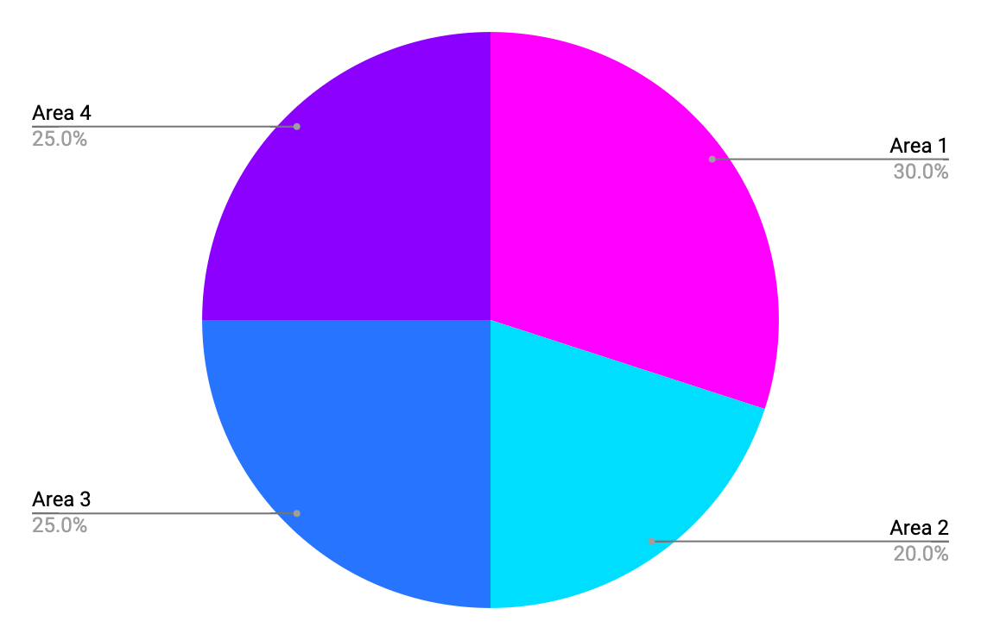
What are we going to do next quarter?
Area 1
Area 2
Area 3
Area 4
Follow the link in the graph to modify its data and then paste the new one here. For more info, click here

Slide 12
Our ideas
Ideas | Budget | When | Team | Comments | Rating
Idea 1 | Budget 1 | Insert the date | Team 1 | Comment 1 | 4/5
Idea 2 | Budget 2 | Insert the date | Team 2 | Comment 2 | 1/5
Idea 3 | Budget 3 | Insert the date | Team 3 | Comment 3 | 3/5
Idea 4 | Budget 4 | Insert the date | Team 4 | Comment 4 | 2/5
Idea 5 | Budget 5 | Insert the date | Team 5 | Comment 5 | 5/5
Idea 6 | Budget 6 | Insert the date | Team 6 | Comment 6 | 4/5

Slide 13
“Exclusive
and inspiring”

Slide 14
Process for the next project
Planning phase
Development
Testing
Content creation
Pre-launch
Launch
Post-launch follow-up
Evaluation

Slide 15
Organizational chart
CEO
Manager 1
Manager 2
Team Leader 1
Team Leader 2
Team Leader 1
Team Leader 2
Employee 1
Employee 2
Employee 3
Employee 4
Employee 5

Slide 16



Life's moments
Don't let life's special moments slip away—capture and preserve them through photographs. In this newsletter we want to show you these special moments!

Slide 17



Testimonials
"I'm continually impressed by the valuable insights this newsletter provides. It's become a must-read in my inbox"
—Laura Patterson
"The diverse range of topics covered in each edition keeps me engaged and looking forward to more"
—John Nelson
"This newsletter has quickly become my go-to source for thought-provoking content. Kudos to the team!"
—Peter James

Slide 18
Case studies
Campaign objective
Results
Write your campaign objective here. It’s important to be concise and clear
23%
30%
10%
Increase in website traffic
Increase
in sales
Increase
in clicks
Approach
Key takeaway 1
Partnering with influencers who align with the same values we have
Developed a comprehensive approach that addressed various aspects of the challenge
Utilized data analysis to inform decision-making
Employed cross-functional teamwork for an ideal solution
Key takeaway 2
Highlighting the unique qualities of our project/product or idea

Slide 19
Thanks
Do you have any questions?
addyouremail@freepik.com
+91 620 421 838
yourwebsite.com
Please keep this slide for attribution

